Slide 1
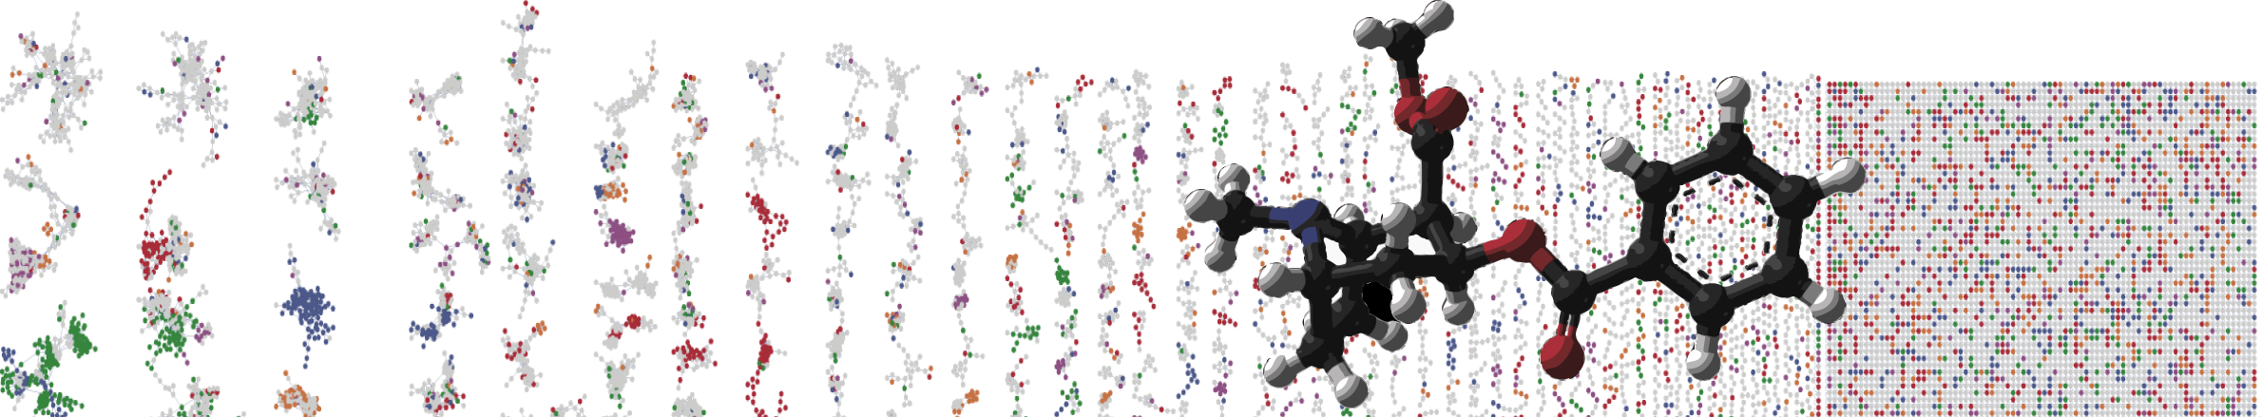


Network Annotation Propagation
Hands-on
PRESENTER’S NAME
University of California - San Diego

Slide 2
Materials and Data
Network Annotation Propagation
https://ccms-ucsd.github.io/GNPSDocumentation/nap/
GNPS Feature-Based Molecular Networking Workshop - American Gut subset with metadata for plant consumption
MassIVE dataset MSV000082678.

Slide 3
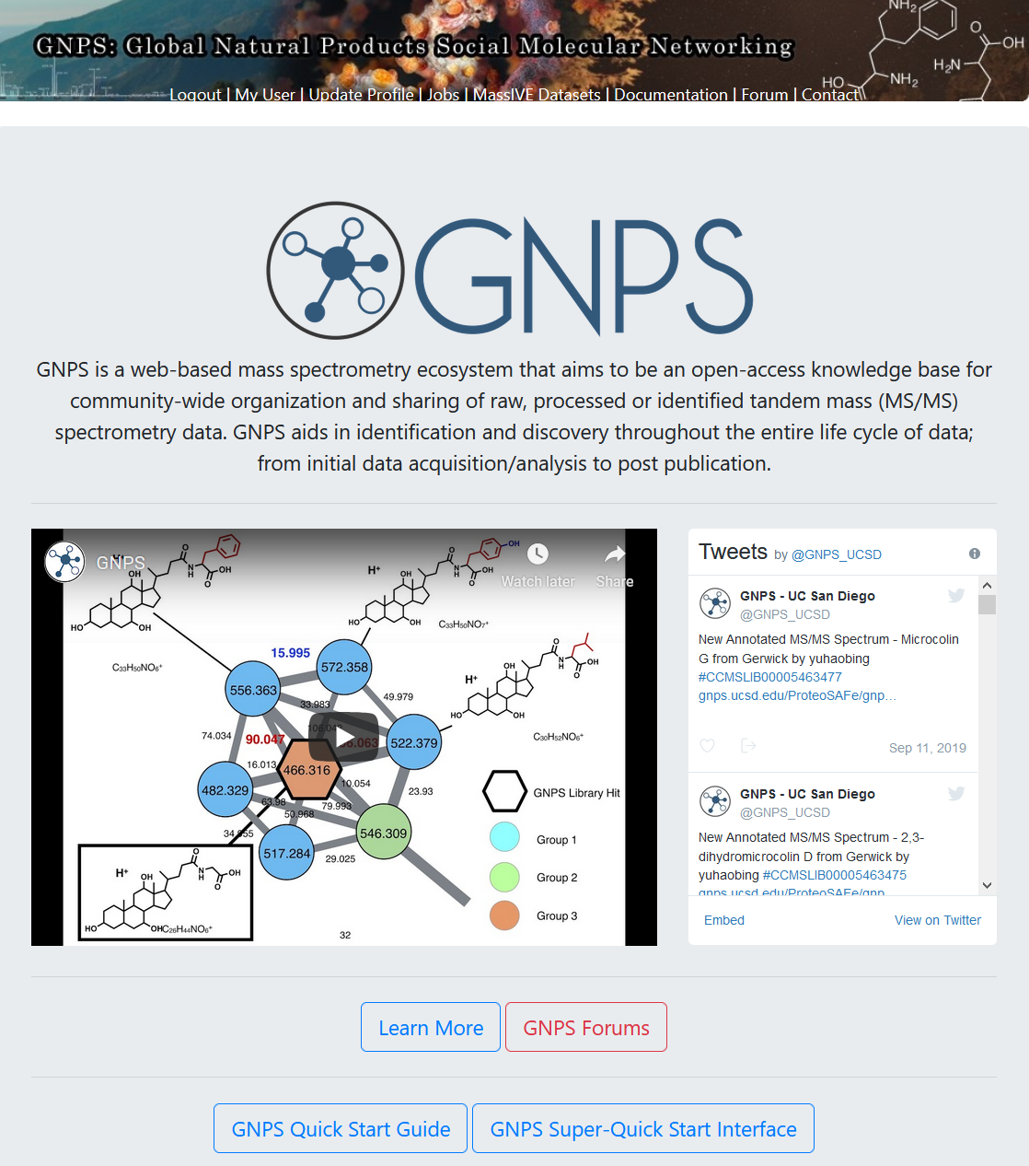

Slide 4
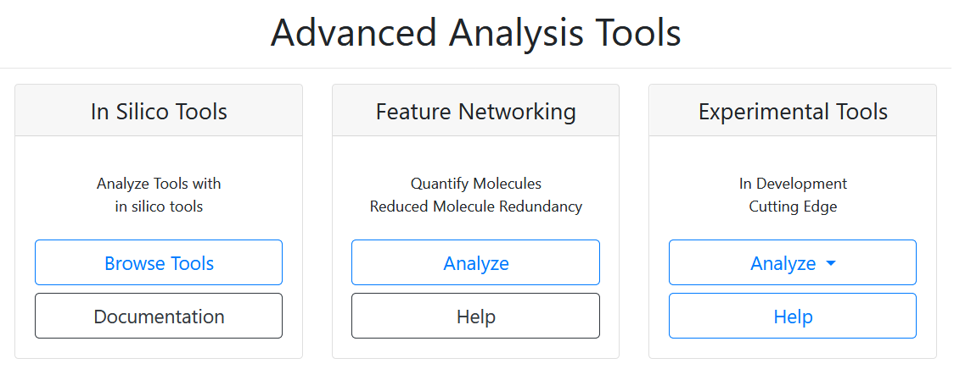

Slide 5
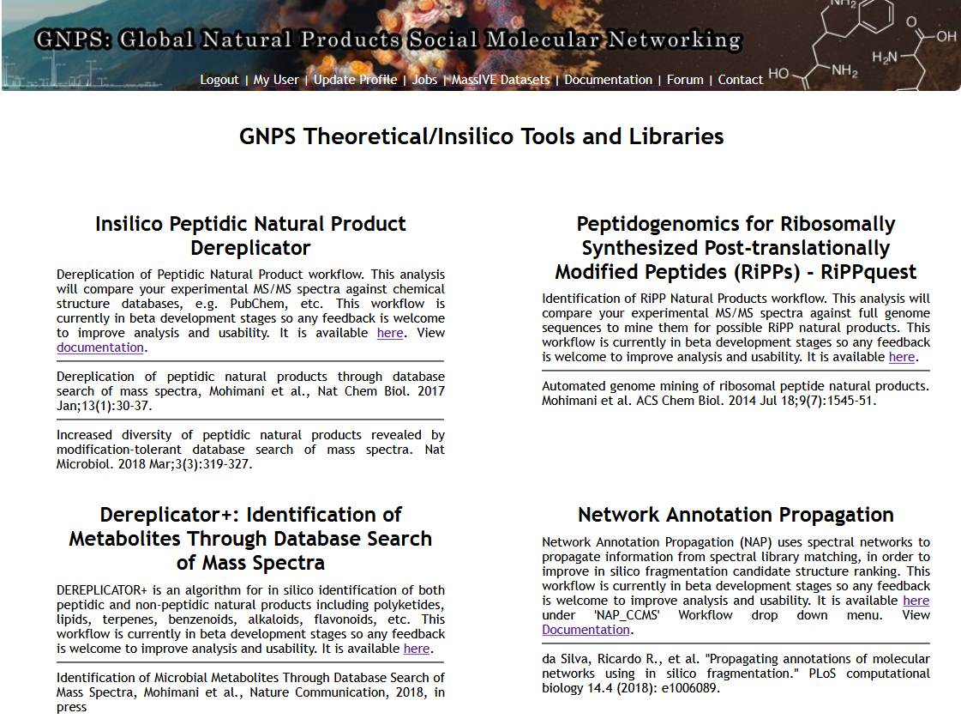

Slide 6
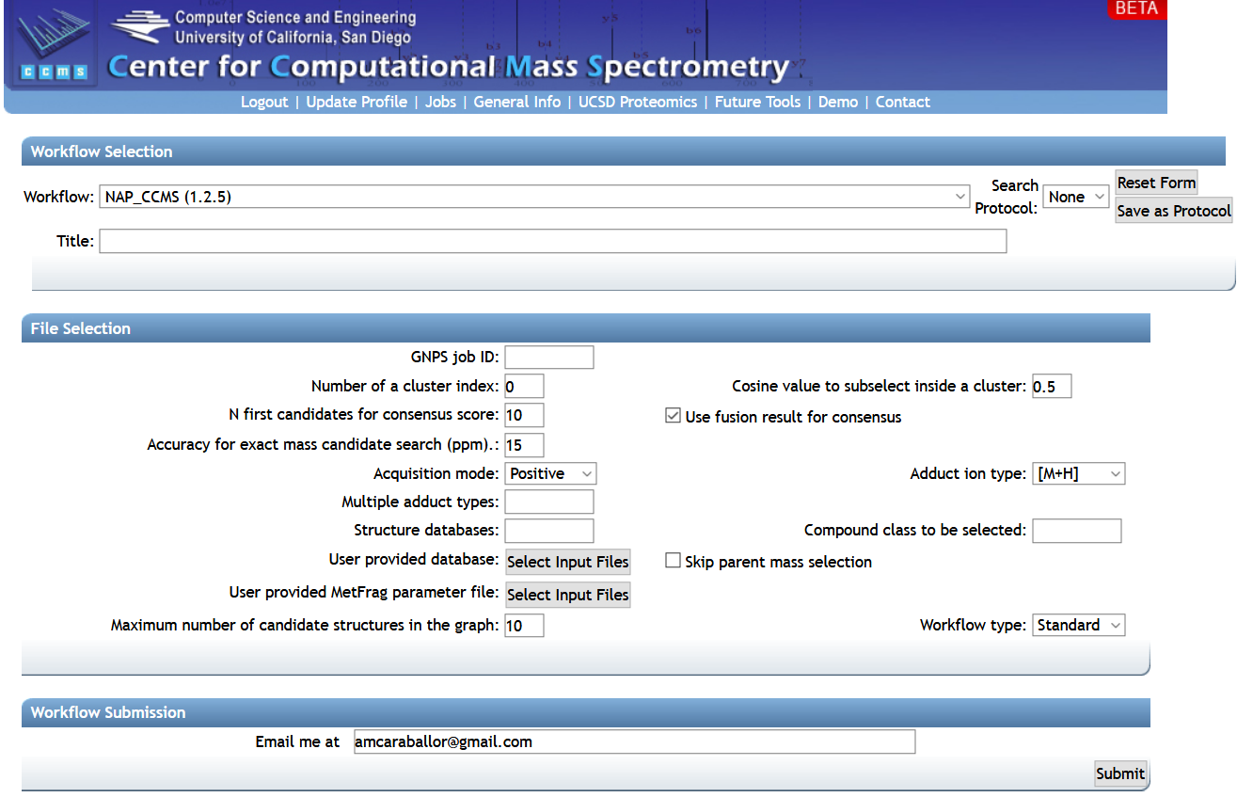
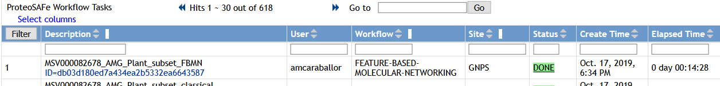

Slide 7
It is recommended to explore molecular families of interest
(select a cluster index of interest)

Slide 10
Available options: GNPS, HMDB, SUPNAT, CHEBI, DRUGBANK and FooDB

Slide 11
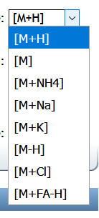

Slide 12
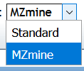

Slide 13
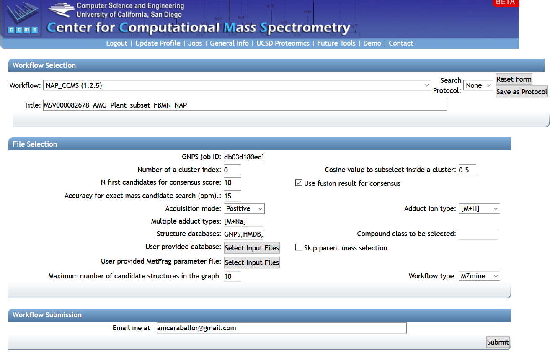
Run time ~1h for the entire network. It is recommended to explore molecular families of interest (select a cluster index of interest)

Slide 14
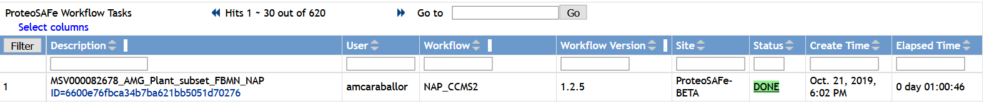
When NAP job is done, go to the Jobs window in:
https://proteomics2.ucsd.edu/ProteoSAFe/jobs.jsp

Slide 15
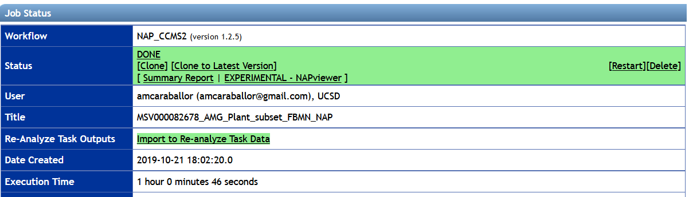
When NAP job is done, go to the Jobs window in:
https://proteomics2.ucsd.edu/ProteoSAFe/jobs.jsp

Slide 16
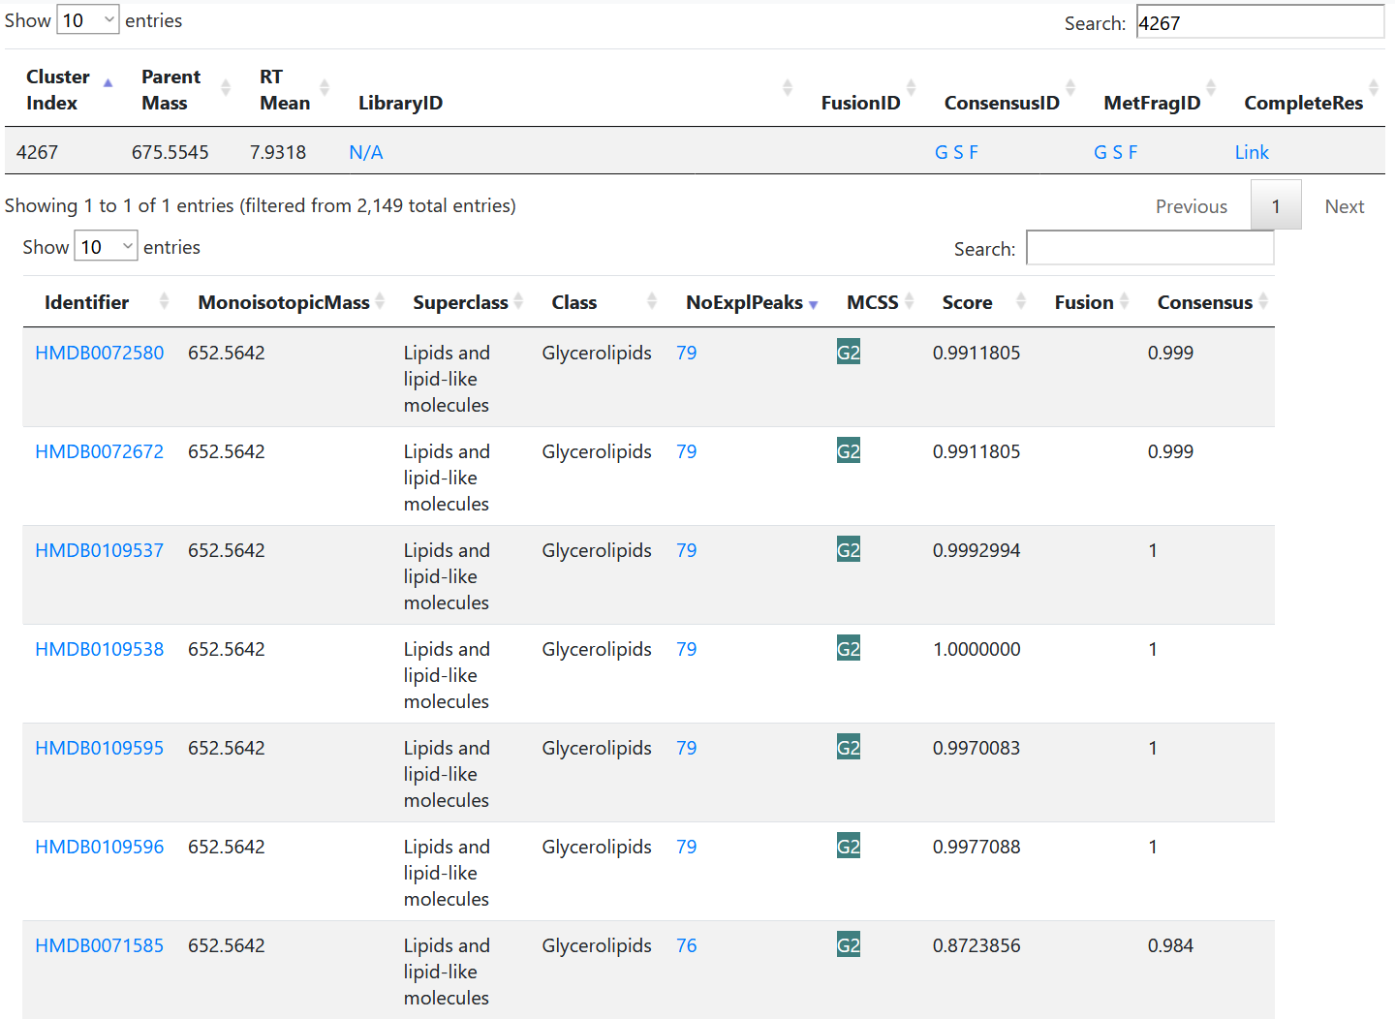
Explore results with NAPviewer
Search for the cluster of interest

Slide 17
Explore results with NAPviewer

Slide 18
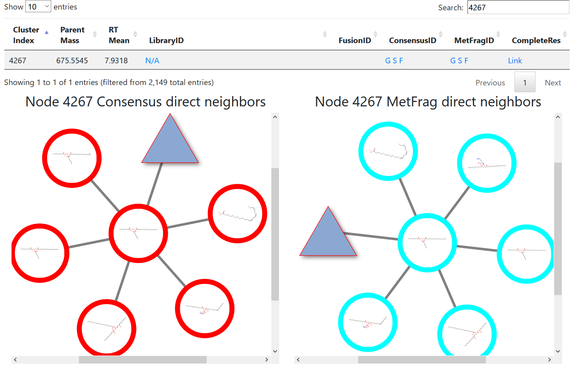
Explore results with NAPviewer
Inspect the candidates

Slide 19
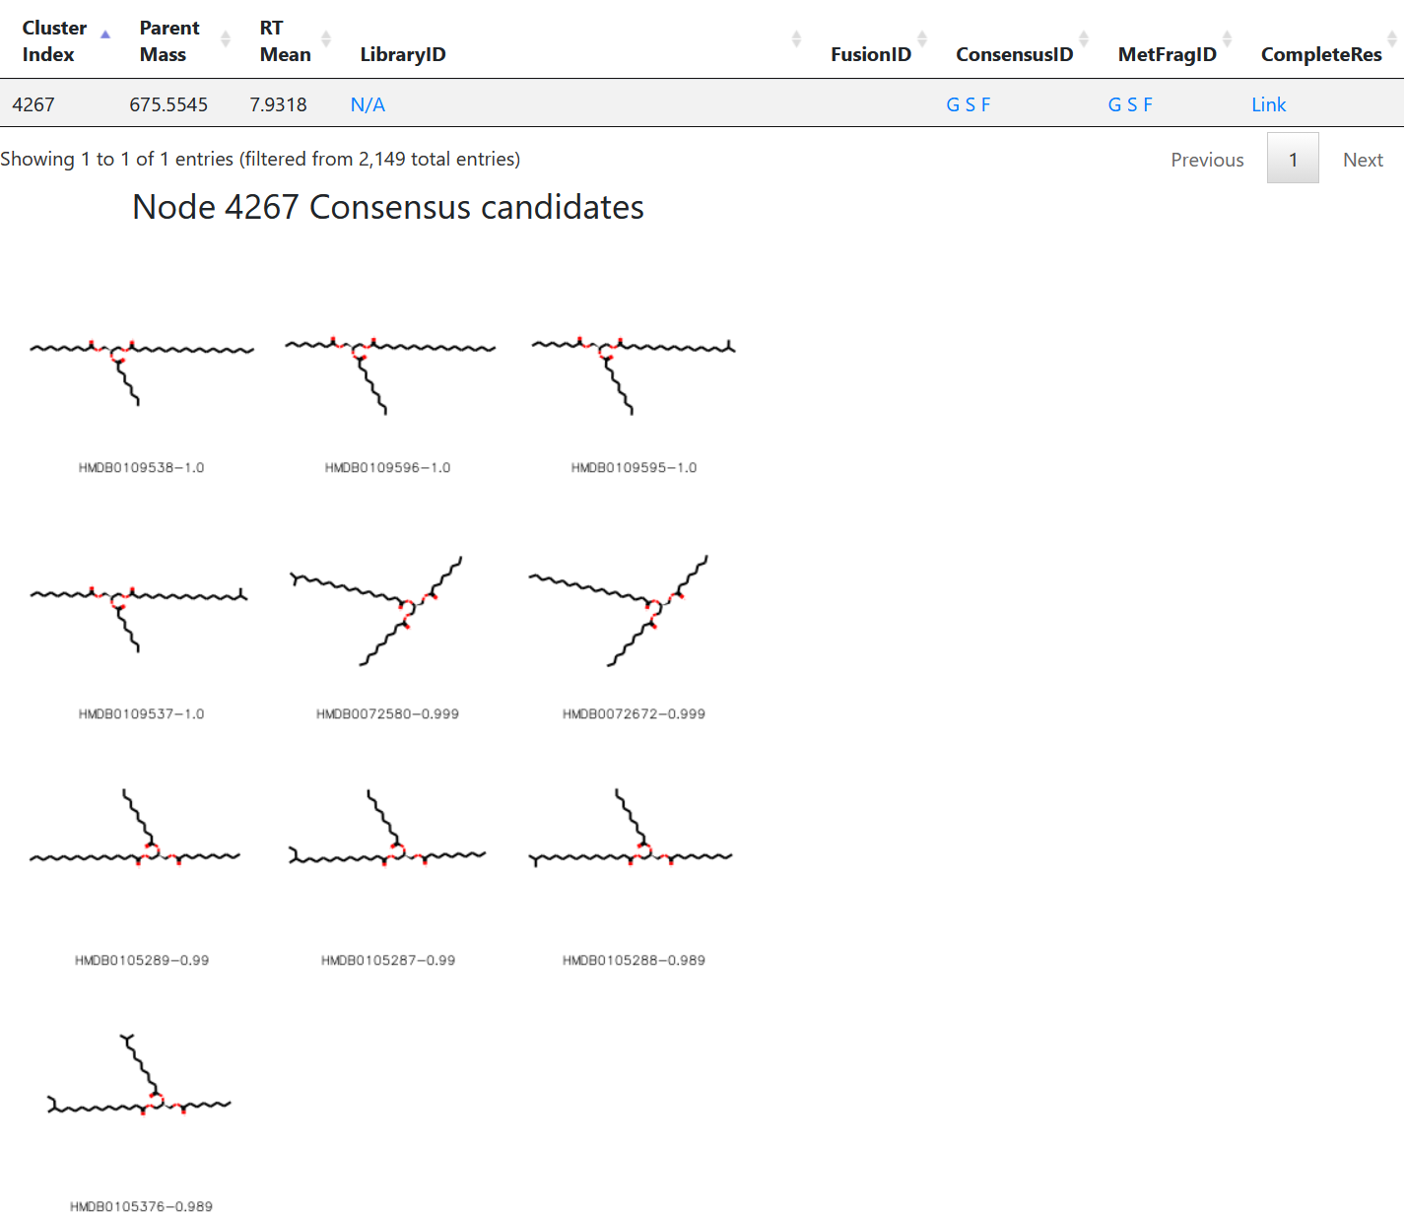
Explore results with NAPviewer
Inspect the candidates

Slide 20
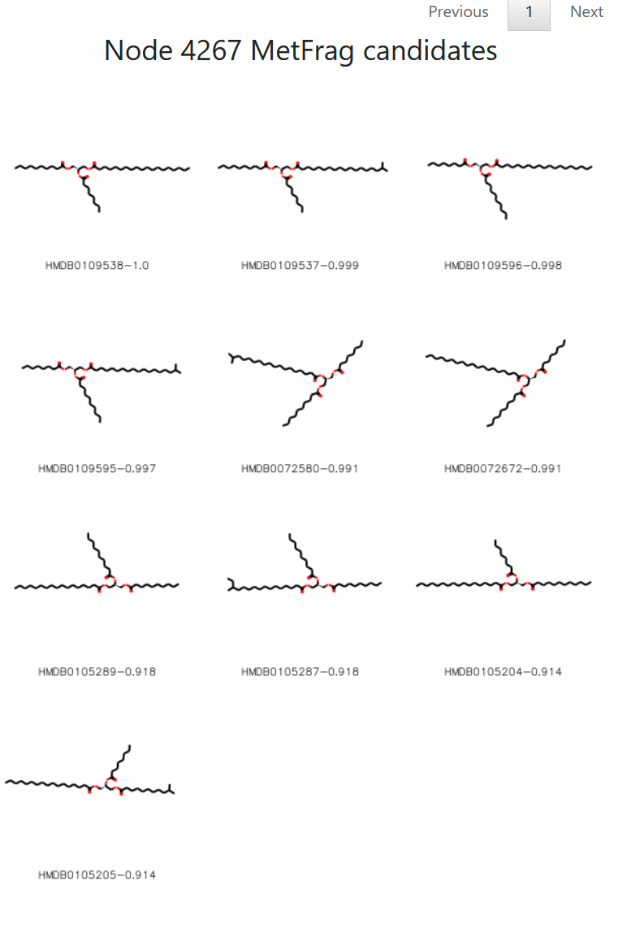
Explore results with NAPviewer
Inspect the candidates

Slide 21
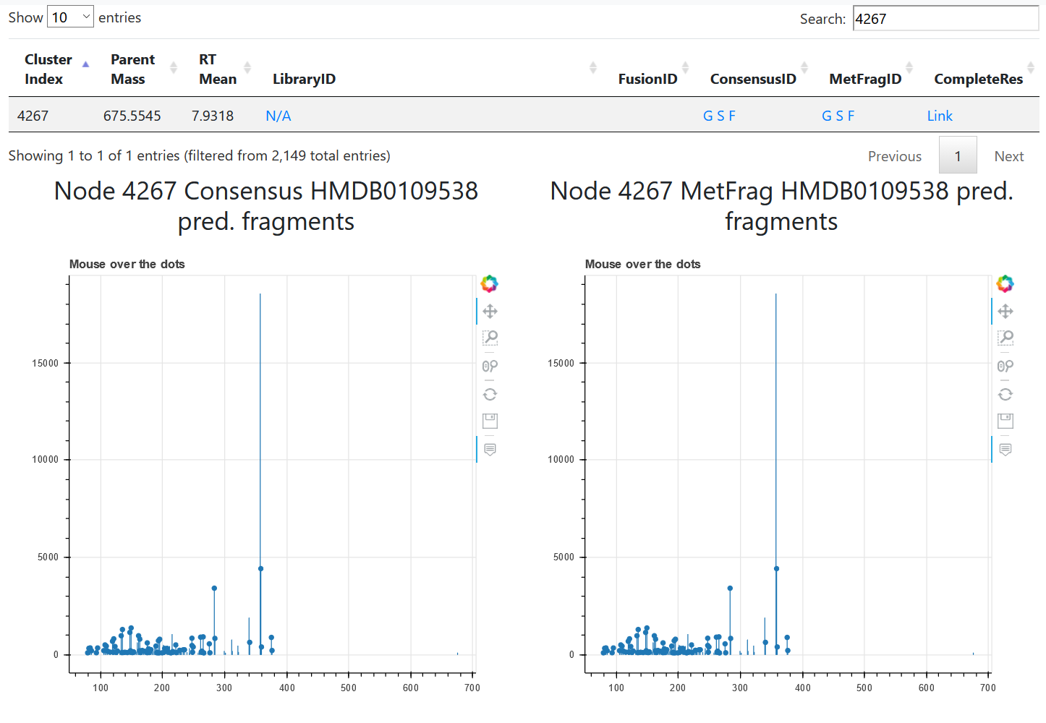
Explore results with NAPviewer
Inspect the predicted fragment that match your data

Slide 22
Questions, Problems or Bugs?
Documentation: https://ccms-ucsd.github.io/GNPSDocumentation/
Forum: https://groups.google.com/forum/#!forum/molecular_networking_bug_reports
PRESENTER’S NAME
Presenter’s e-mail

